Slide 1




THE RISK OF SNIFFERS IN COMPUTER NETWORK
COE390 - Final Presentation

Slide 2
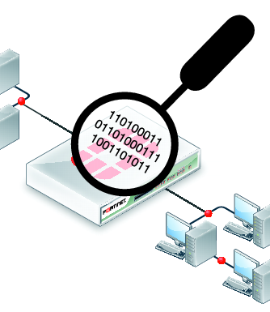
Introduction
The packet sniffer captures the data that is addressed to other machines, saving it for later analysis. It can be used legitimately by a network or system administrator to monitor and troubleshoot network traffic , but it is sometimes used for spying purposes and to expose network user data. Let's get to know unethical sniffing.

Slide 3
Wrong use or unethcal
Tools are sometimes used wrongly or unethically, such as sniffing . can use sniffer be for personal goals or interests.
the potential risks privacy of network users can be violated

Slide 4







Motives the attackers from sniffing:
Getting username an passwords
Motives the attackers from sniffing:
Stealing bank related/
transaction related information
Getting username an passwords
Spying on email and chat messages
Stealing bank related/transaction related information
Spying on email and chat messages
Identity theft
Identity theft

Slide 5
Types of Sniffing
There are two types of sniffing- active and passive. As the name suggests, active involves some activity or interaction by the attacker in order to gain information. In passive the attacker is just hiding dormant and getting the information

Slide 6
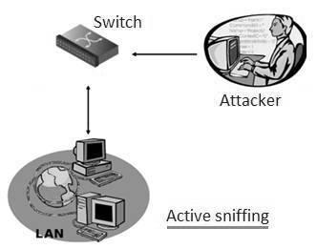
Active sniffing
Active : In this sniffing type, attacker directly interacts with target machine by sending packets and receiving responses.
This sniffing is carried out through Switch. In this type, attacker tries to poison the switch by sending bogus MAC address.
- Examples of active sniffing : ARP spoofing, MAC flooding, HTTPS and SSH spoofing, DNS spoofing etc.

Slide 7
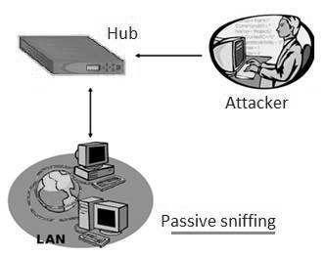
Passive sniffing
Passive : In this sniffing type, attacker does not interact with the target. He/she simply hook on to the network and captures packets transmitted and received by the network or exchanged between two machines.
This sniffing is carried out through hub. An attacker connects to the hub from his/her machine. Attacker needs account on the LAN.
-Examples of passive sniffing: Hub based networks or wireless networks

Slide 8
How do you identify a Sniffer?
Identifying the type of sniffer can depend on how sophisticated the attack is. It is possible that the sniffer may go undetected for a large amount of time hiding in the network. There is some anti-sniffer software available in the market to catch the intruders but it may be possible that the sniffers get away with it creating a false sense of security.

Slide 9
How does a person secure their data ?
If you are connected to a public network or an insecure network, you may be exposed to these attacks. One of the ways that preserves your privacy within the network is by using VPN ( Virtual Private Network )

Slide 10
Thanks for listening
The presenter: Khaled Mofdhi ALSHAMMARI

